Slide 1
Teenage Behaviour Marie, Sarah and Georja Outreach workers Dearne Family Centre

Slide 2
Introduction
Parents often feel that their teenager’s behaviour is a mystery and they don’t understand them anymore. Sometimes it may even feel that they specifically designed to irritate parents!
They have a ‘flip flop’ of emotions, they don’t always listen and challenge authority.
It can almost feel like you have lost that little child you once had, this can all make you feel like a bad parent and that you are failing.
Understanding adolescent development helps you as a parent understand what your teenager is going through and how this affects their behaviour.

Slide 3
The Teenage brain
Notes:
The amygdala develops sooner than the pre frontal cortex meaning teenagers take risks without thinking of the consequences. Fight or flight mode.

Slide 4
Common worries
We all have worries as parents around;
. Sex
. Drugs & alcohol . Unsuitable friends/peer pressure . Social media . Going out at night

Slide 5
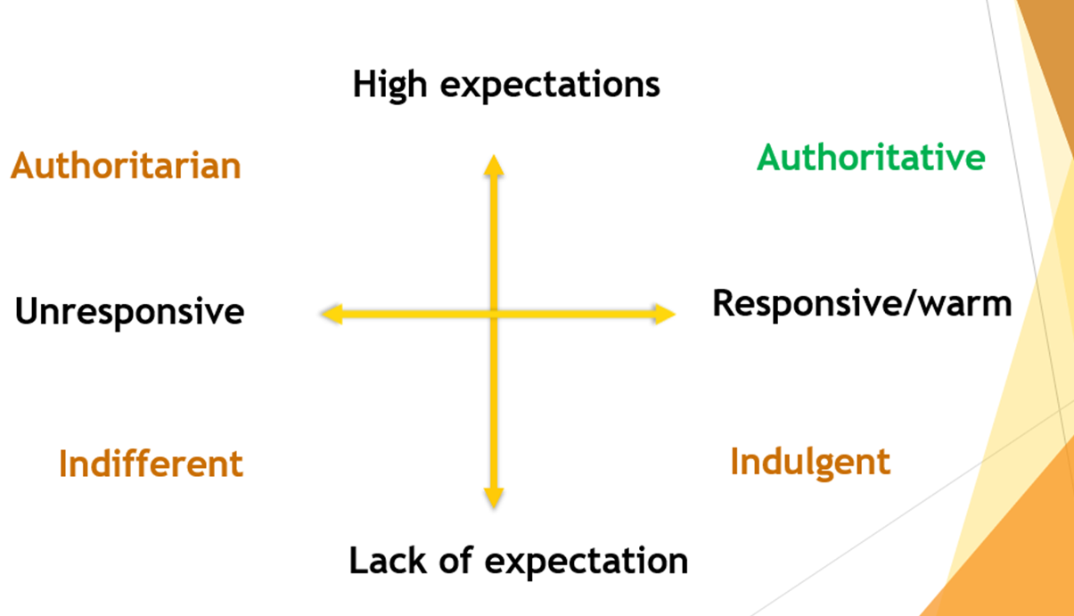
Parenting styles
Notes:
If you have some of these common worries, when dealing with these issues there are different ways of parenting.
How do we keep the balance of love, warmth but also safety and protection? Authoritative parents provide structure and support of the ‘trainee adult’. Parents need to allow adolescents to make age approve choices and to experience decision making, learning from their own mistakes. You still need to be there to support them, you matter even when it doesn't seem that way. They still need and look for boundaries even though they often will test them.

Slide 6
Communication
Communication is a two-way thing!
70% of communication is non-verbal – Body language, facial expressions, gestures & eye contact.
Teenagers only have 75% of the vocabulary that adults have, often leading to teens feeling less confident to express in words how they feel. This may cause outbursts (shouting, crying, slamming doors, breaking items) due to frustration.
When communicating remember things such as the tone of your voice, avoid using sarcasm, the timing. and environment of the conversation
Notes:
Communication is a two way thing, 70% is body language
it is a skill that has to be learnt, 14/15 year olds only have 75 % of the vocabulary adults have
Having 75% of the vocab of adults leads to frustration when trying to verbally express themselves, ending often in outbursts of emotion, crying, lashing out, throwing things, slamming doors, breaking items, shouting). Fight or flight response in these difficult situations. Leading to embarrassment.
When communicating avoid using sarcasm, even when your teen does something you would normally have to ask 10 times! Make sure you use an appropriate tone and think about the environment when having a conversation. Face to face can sometimes feel intimidating, try going for a walk, cooking or drawing, this can feel less intimating without eye contact leading to a more open conversation. Mutual respect is very important, how they are treated will shape the adults they become. Being able to communicate their feelings and opinions even if they differ from yours is important, being respectful of these will build on your relationship.

Slide 7
Notes:
These are different response types. Submissive, “ I’ll clean up your mess, its okay, ill watch Eastenders later”. Not having boundaries, powerless adult.
Passive aggressive “Don’t mind me, I’ll clear up all your mess again but I might not bother making you any tea later”. Manipulative, sarcastic, may lead to an argument or returned aggression.
Aggressive “You’ve left a mess yet again. You’re so lazy and selfish. Why do you always leave it for everyone else to do? That’s enough – you can sort your own tea I tonight!” Blaming messages, power struggle. Often leading again to returned aggression. These situations are difficult, when you are having to constantly ask your teen to do something is gets frustrating. Using aggressive statements will not lead to change, only to mirrored behaviour and attitude.

Slide 8
“I” Statements
Aggressive: using a YOU statement….
“You always leave the kitchen in such a mess, you’re just lazy and selfish. You can make your own tea.”
Instead try;
Assertive: using an I statement….
“It makes me really upset to see the kitchen in such a mess when I get home from work, I would really apricate it we could all clear away the pots we use and wipe down the side so that tea can be made”.
Notes:
So looking at a way to deal with these situations affectively we could try using I statements
Using aggressive statements and tones leads to increase stress and often returned aggression from the young person. Avoiding the word “YOU” when communicating about something that the teen has done will make them feel less blamed. Instead using an assertive tone and wording with the word “I” allows the teens to see how things make you feel. Triggering empathy. When faced with a clam assertive manor it is less liking for them to return with aggression.

Slide 9
Praise
What we pay more attention to is what we get more of!
Punishment only represses behaviour it does not lead to change.
Reward and positive attention on the other hand leads to altered behaviour.
Notes:
Praise is important. What we pay more attention to is what we get more of!
Punishment only represses behaviour it does not lead to change
Reward and positive attention on the other hand leads to altered behaviour. Praise even the small things, showing interest and attention to actions and behaviours that are positive will drive change.
Obviously there are times where consequences are needed. Respectfully talking these through with your teen, explaining why these are in place allows for learning, learning from mistakes rather than approaching aggression and power which would result in the mirrored behaviour.

Slide 10
Boundaries and rules
Boundaries and rules are needed to keep us safe.
Have a discussion so that your teen feels included rather than being told what to do!
Getting the power balance right. Even though ultimately the adult is in charge, allowing the teen to be involved in setting the rules and boundaries.
Notes:
Boundaries and rules are needed to keep us safe
Have a discussion so that your teen feels included rather than being told what to
Mutual respect is very important, how they are treated will shape the adults they become.
Getting the power balance right. Even though ultimately the adult is in charge, allowing the teen to be involved in setting the rules and boundaries
If you are aiming a rule towards your teen, saying it in a way that is less obvious. E.g, “We all must put our washing into the washing basket to make sure it can be washed”
Often families find writing and all signing the rules together affective

Slide 11
https://www.youtube.com/watch?v=LMhunB9w2Aw

Slide 12
Top Tips
You are important to your teen.
Always look for positives.
Remember your teenager is unique and appreciate their strengths.
Remember to listen.
Encourage and be open to their views, whether about sport, TV programmes, music, current news, or events.
Provide structure not too much, not too little.
Keep some emotional distance – if they are angry, it is more about them than it is about you.
You are probably doing a better job than you realise!
Find some support for you.
You are not alone!
Notes:
Teenage years do not last forever, don’t ruin your relationship over a few years, things will get better.

Slide 13
Any questions?

