Slide 1
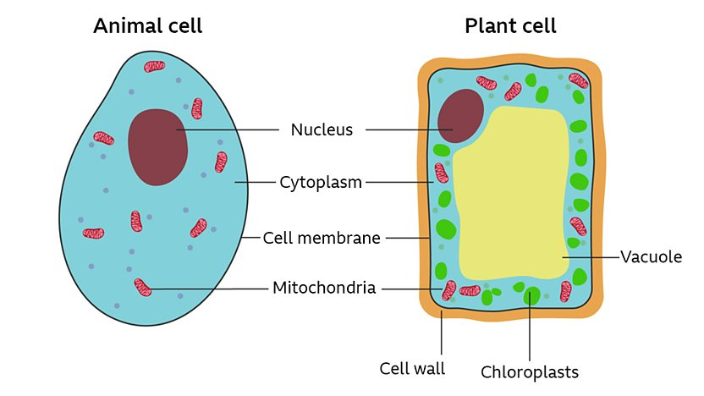
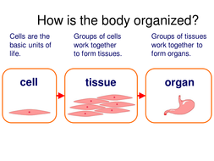
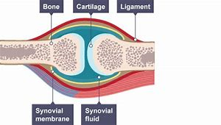
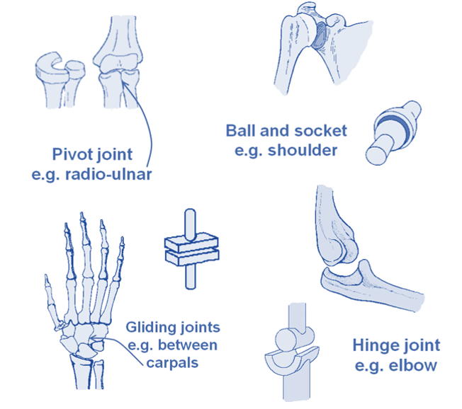
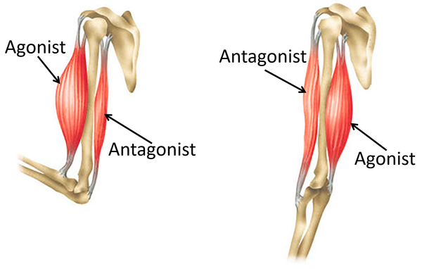
Cells
Key Words | Definition
Cell | The unit of a living organism, contains parts to carry out life processes
Tissue | Group of cells of one type
Organ | Group of different tissues working together to carry out a job
Diffusion | One way for substances to move into and out of cell
Cell Membrane | Surrounds the cell and controls movement of substances in and out
Nucleus | Contains genetic material (DNA) which controls the cell’s activities
Vacuole | Area in a cell that contains liquid, and can be used by plants to keep the cell rigid and store substances
Mitochondria | Part of the cell where energy is released from food molecules
Cell Wall | Strengthens the cell. In plant cells it is made of cellulose
Uni- cellular | Living things made up of one cell
Multi-cellular | Living things made up of many types of cell
Key Diagrams
Key Points
Three types of unicellular organisms are Algea, fungus and bacteria
Unicellular organisms can be broken into two:
Prokaryotes - (‘before life’ thought to be first organism to live on earth e.g. bacteria
Eukaryotes - contain a nucleus, surrounded by nuclear membrane, mitochondria, chloroplasts and vacuoles e.g. yeast & amoeba
Animal cells become specialised so they can carry out a particular job e.g. sperm cell, nerve cell, muscle cell
Diffusion- a process by which substances move from an area of high concentration to one of low concentration until concentrations are equal
Multicellular organisms organisms that consist of more than one cell e.g animals and land plants
Hold the microscope by the arm and support the base when carrying it around the lab.
Eye piece lens – The part you look through.
Objective lens – Usually the light microscope has three of these and they can be used to observe the slide at different magnifications.
Coarse adjustment screw – this adjusts the height of the stage, to help focus the image.
Fine adjustment screw – this adjusts the height of the stage very slightly
Stage – the part of the light microscope where the slide is placed.
Cover slip – a small glass square, placed on top of the specimen on the microscope slide.
Movement
Antagonistic muscle pair | Muscles working in unison to create movement.
Bone Marrow | Tissue found inside some bones where new blood cells are made.
Cartilage | Smooth tissue found at the end of bones, which reduces friction between them
Joints | Places where bones meet
Ligaments | Connect bones in joints
Tendons | Connect muscles to bones
Key Diagrams
Skeleton – bones in your body, give the body structure, protect vital organs and produce blood
Muscles move joints, each joint needs two muscles to make it work, one muscle moves the joint in one direction the other muscles in the opposite
Muscles working by contracting and getting shorter in length, this pulls the bone and moves the joint

